Slide 1
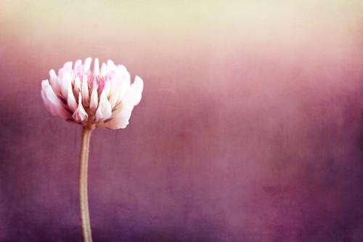
A House for Our Dreams
by Rev. Dori Somers
We, all of us, build houses for our dreams.
The masonry and lumber, glass and tiles,
A solid form, wherein we see our hopes,
A shelter and protection for our growth.
This house shall be a dwelling place
For courage, for integrity, for love
Engendered, nourished by a family
That speaks of “we” and means all humankind.
These walls shall represent the privacy
And dignity of individuals,
The open doors, a welcome to all people,
All ages, and all generations.
The windows shall keep light of inquiry
Illumining from outside and within.
May all words spoken here be born of love
And energy rekindle in the hearts
Of those who dreamed this house—who plied the tools
And paid the price to actualize the dream.
May dreaming never cease for those within
Who know the world to be a troubled place,
But dare to struggle with imperfectness
Toward that brighter hope, that better day.
Let memories add warmth...a heritage,
A quilted patchwork stitched with history
Of kindliness, of daring for the good,
Of funny moments, jokes and smiles and tears.
This is a precious place, as every home
That shelters those who love and strive and share.
Its blessing is in lives that meet within...
In living, learning, caring, sheltered here.
---
We Are Unitarian Universalists

Slide 2
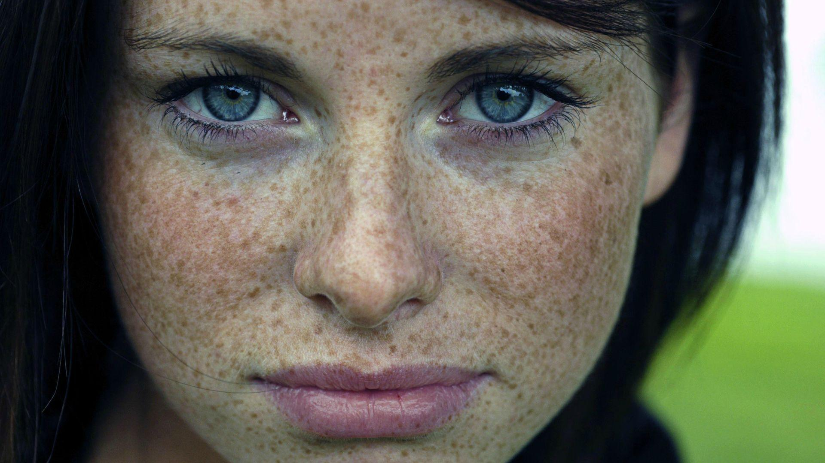
Blessed Are We
by Andrea Hawkins-Kamper
Blessed are we who gather with open hearts, together, in this space, today.
Blessed are we: the chalice-lighters of resistance, justice, love, and faith.
Blessed are we: the heretics, the outcasts, the walkers of our own way.
Blessed are we: the border-crossers, the refugees, the immigrants, the poor, the wanders who are not lost.
Blessed are we: the transgressors, the trespassers, the passers-by, the cause-takers, the defiant, the compliant.
Blessed are we: the hand-extenders, the sign-makers, the protestors, the protectors.
Blessed are we: the trans women, the trans men, the non-binary, the cisgender, the multi-gender, the no gender.
Blessed are we: the friend, the stranger, the lonely, the hidden, the visible, the authentic.
Blessed are we who rise in solidarity, blessed are we who cannot, blessed are we who do not.
Blessed are we for this is our Beloved Community, and this is who we are.
---
We Are Unitarian Universalists

